Slide 1
Chapter7 Internal Sorting
7.1 Terminology and notation
7.2 Three Θ(n²) Sorting Algorithms
Insertion Sort
Bubble Sort
Selection Sort
7.3 Shell Sort
7.4 Quick Sort
7.5 Merge Sort
7.6 Heap Sort
7.7 BinSort and Radix Sort
7.8 Empirical Comparison of Sorting Algorithms
7.9 Lower bounds for Sorting
再次复习：5,6,10,14,1,21,30,32,48,49,51,60,61,75,78,88-90

Slide 2
Sorting Terminology
Given a sequence of records R₁ , R₂ , … , R_{n} with key values k₁ , k₂ ,… , k_{n} , respectively, arrange the records into any orders such that records R_{s1},R_{s2},…,R_{sn} have keys obeying the property k_{s1} ≤ k_{s2} ≤ …≤ k_{sn}.
A sort algorithm is said to be stable if it does not change the relative ordering of records with identical key values.
k5
k3
k4
k2
k6
k1
k5<k3<k4<k2 = k6<k1
stable
k1
k2
k3
k4
k5
k6
k5
k3
k4
k6
k2
k1
unstable

Slide 3
Sorting Terminology
Internal Sorting (内部排序)：指的是待排序记录存放在计算机随机存储器中进行的排序过程。
External Sorting (外部排序)：指的是待排序记录的数量很大，以致内存一次不能容纳全部记录, 在排序过程中尚需对外存进行访问的排序过程。

Slide 4
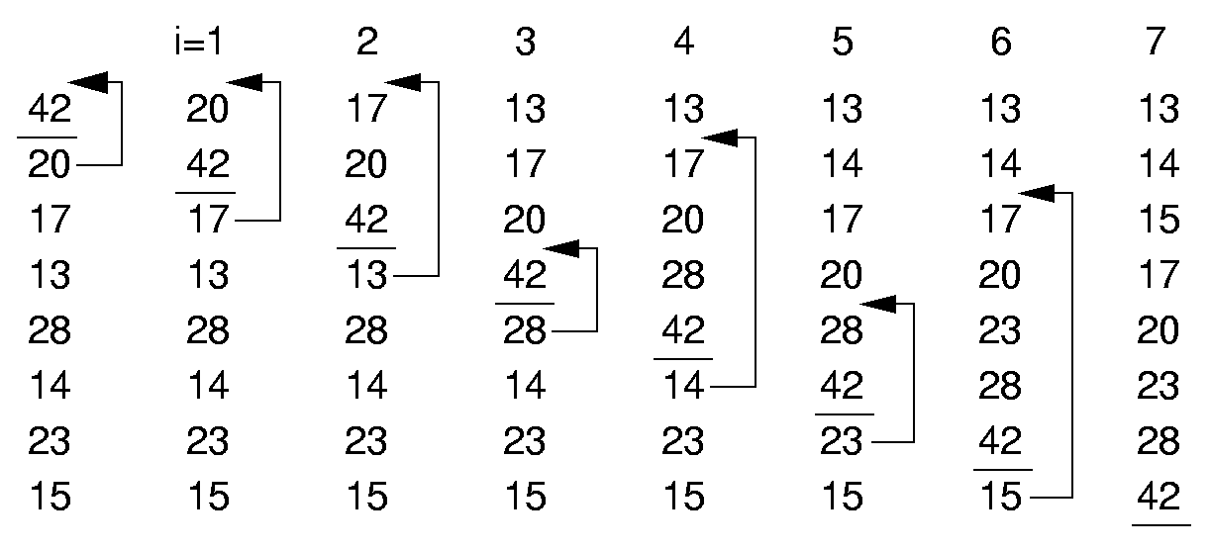
Insertion Sort (1)
In the iteration i, insert the NO. i record

Slide 5
Insertion Sort (2)
template <class Elem>
void inssort(Elem A[], int n) {
for (int i=1; i<n; i++)
for (int j=i; (j>0) &&
(A[j]< A[j-1])); j--)
swap(A, j, j-1);
}
i=2
20
17
42
18
i=2
17
20
42
18
i=3
17
20
42
18
i=3
17
20
18
42
i=3
17
18
20
42
i=1
i=1
20
42
17
18
i=2
20
42
17
18
42
20
17
18
j
j
j
j
j
j
j
j
Notes:
Best case is 0 swaps, n - 1 comparisons.
Worst case is n²/2 swaps and comparisons.
Average case is n²/4 swaps and comparisons.
This algorithm as the best possible best case performance. This will be important later.

Slide 6
Insertion Sort (3)
template <class Elem>
void inssort(Elem A[], int n) {
for (int i=1; i<n; i++)
for (int j=i; (j>0) &&
(A[j]< A[j-1])); j--)
swap(A, j, j-1);
}
Best Case: 0 swaps, n - 1 comparisons Θ(n)
Worst Case: n(n-1)/2 swaps and comparisons Θ(n²)
Average Case: n (n-1)/4 swaps and comparisons Θ(n²)
Insertion Sorting algorithm is Stable
Notes:
Best case is 0 swaps, n - 1 comparisons.
Worst case is n²/2 swaps and comparisons.
Average case is n²/4 swaps and comparisons.
This algorithm as the best possible best case performance. This will be important later.

Slide 7
Insertion Sort (4)
template <class Elem>
void inssort(Elem A[], int n) {
for (int i=1; i<n; i++)
for (int j=i; (j>0) &&
(A[j] < A[j-1])); j--)
swap(A, j, j-1);
}
Insertion Sorting algorithm is Stable.
i=1
i=1
20
42
17
17
i=2
20
42
17
17
i=2
20
17
42
17
i=2
17
20
42
17
i=3
17
20
42
17
i=3
17
20
17
42
i=3
17
17
20
42
42
20
17
17
Notes:
Best case is 0 swaps, n - 1 comparisons.
Worst case is n²/2 swaps and comparisons.
Average case is n²/4 swaps and comparisons.
This algorithm as the best possible best case performance. This will be important later.

Slide 8
Bubble Sort(冒泡排序) (1)
一次冒泡的过程：
42
20
17
13
28
14
23
15
42
20
17
13
28
14
15
23
42
20
17
13
14
28
15
23
42
20
13
17
14
28
15
23
42
13
20
17
14
28
15
23
13
42
20
17
14
28
15
23
最小的元素冒出来
逆序交换

Slide 9
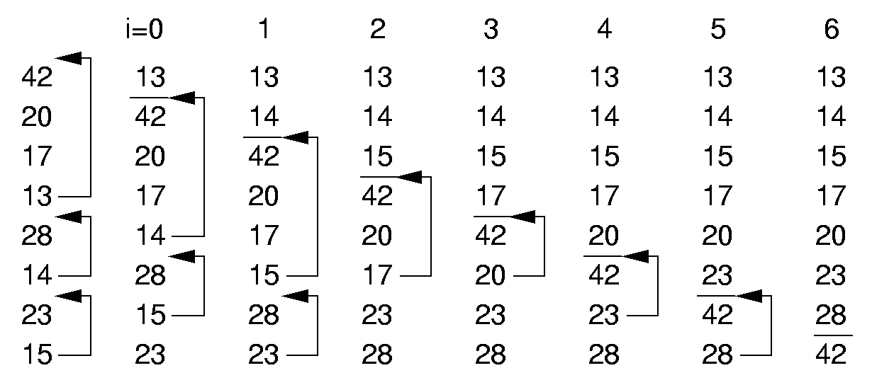
Bubble Sort(冒泡排序) (2)
逆序交换, 第i次冒泡的区间是[i, n-1]

Slide 10
Bubble Sort (3)
template <class Elem>
void bubsort(Elem A[], int n) {
for (int i=0; i<n-1; i++)
for (int j=n-1; j>i; j--)
if (A[j]< A[j-1])
swap(A, j, j-1);
}
Notes:
Best case is 0 swaps, n²/2 comparisons.
Worst case is n²/2 swaps and comparisons.
Average case is n²/4 swaps and n²/2 comparisons.
This algorithm has no redeeming features whatsoever. It’s a shame this algorithm typically gets taught to intro students in preference to the far superior insertion sort algorithm.

Slide 11
Bubble Sort (4)
template <class Elem>
void bubsort(Elem A[], int n) {
for (int i=0; i<n-1; i++)
for (int j=n-1; j>i; j--)
if (A[j]< A[j-1])
swap(A, j, j-1);
}
Best Case: 0 swaps, n(n-1)/2 comparisons Θ(n²)
Worst Case: n(n-1)/2 swaps and comparisons Θ(n²)
Average Case:
n(n-1) /4 swaps and n(n-1) /2 comparisons. Θ(n²)
Notes:
Best case is 0 swaps, n²/2 comparisons.
Worst case is n²/2 swaps and comparisons.
Average case is n²/4 swaps and n²/2 comparisons.
This algorithm has no redeeming features whatsoever. It’s a shame this algorithm typically gets taught to intro students in preference to the far superior insertion sort algorithm.

Slide 12
Bubble Sort (5)
template <class Elem>
void bubsort(Elem A[], int n) {
for (int i=0; i<n-1; i++)
for (int j=n-1; j>i; j--)
if (A[j]< A[j-1])
swap(A, j, j-1);
}
Bubble Sorting algorithm is Stable.
42
20
17
13
28
13
23
15
42
20
17
13
28
13
15
23
42
20
17
13
13
28
15
23
42
20
13
17
13
28
15
23
42
13
20
17
13
28
15
23
13
42
20
17
13
28
15
23
13
13
42
20
17
15
28
23
… …
Notes:
Best case is 0 swaps, n - 1 comparisons.
Worst case is n²/2 swaps and comparisons.
Average case is n²/4 swaps and comparisons.
This algorithm as the best possible best case performance. This will be important later.

Slide 13
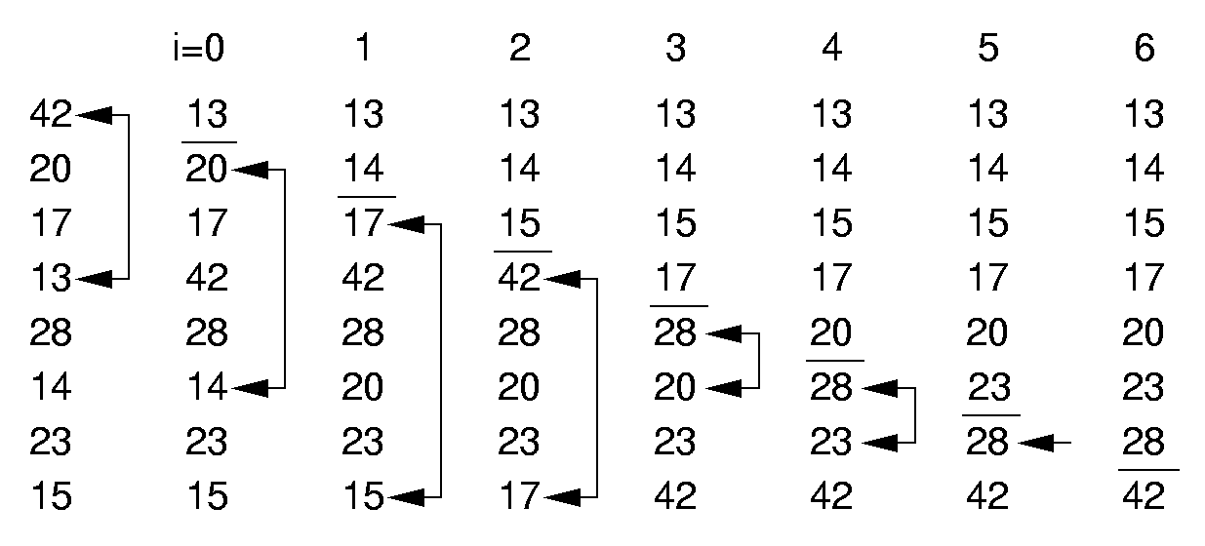
Selection Sort (1)
第i趟排序就是从位置属于[i,n-1]的元素中
选出最小的元素，并将其和第i位置上的元素交换

Slide 14
Selection Sort (2)
template <class Elem>
void selsort(Elem A[], int n) {
for (int i=0; i<n-1; i++) {
// select the minial values in [i,n-1]
int lowindex = i; // Remember its index
for (int j=n-1; j>i; j--) // Find least
if (A[j]< A[lowindex])
lowindex = j; // Put it in place
swap(A, i, lowindex);
}
}
Notes:
Best case is 0 swaps (n-1 as written), n²/2 comparisons.
Worst case is n - 1 swaps and n2/2 comparisons.
Average case is O(n) swaps and n²/2 comparisons.
This is essentially a bubble sort with the swaps deferred. It can be a significant improvement if the cost of swapping is expensive. Note that the algorithm could be implemented to require 0 swaps in the best case by testing the two locations being swapped are not the same. But this test is likely more expensive than the work saved on average.

Slide 15
Selection Sort (3)
template <class Elem>
void selsort(Elem A[], int n) {
for (int i=0; i<n-1; i++) {
// select the minial values in [i,n-1]
int lowindex = i; // Remember its index
for (int j=n-1; j>i; j--) // Find least
if (A[j]< A[lowindex])
lowindex = j; // Put it in place
swap(A, i, lowindex);
}
}
Best Case: 0 swaps , n(n-1)/2 comparisons. Θ(n²)
Worst Case: n - 1 swaps and n(n-1)/2 comparisons Θ(n²)
Average Case: (n-1)/2 swaps and n(n-1)/2 comparisons Θ(n²)
Notes:
Best case is 0 swaps (n-1 as written), n²/2 comparisons.
Worst case is n - 1 swaps and n2/2 comparisons.
Average case is O(n) swaps and n²/2 comparisons.
This is essentially a bubble sort with the swaps deferred. It can be a significant improvement if the cost of swapping is expensive. Note that the algorithm could be implemented to require 0 swaps in the best case by testing the two locations being swapped are not the same. But this test is likely more expensive than the work saved on average.

Slide 16
Selection Sort (4)
template <class Elem>
void selsort(Elem A[], int n) {
for (int i=0; i<n-1; i++) {
int lowindex = i; // Remember its index
for (int j=n-1; j>i; j--) // Find least
if (A[j]< A[lowindex])
lowindex = j; // Put it in place
swap(A, i, lowindex);
}
}
Selection Sorting algorithm is not stable.
i=0
i=1
20
20
17
17
20
20
17
20
20
… …
Notes:
Best case is 0 swaps, n - 1 comparisons.
Worst case is n²/2 swaps and comparisons.
Average case is n²/4 swaps and comparisons.
This algorithm as the best possible best case performance. This will be important later.

Slide 17
Summary
 | Insertion | Bubble | Selection
Comparisons:
Best Case | Θ(n) | Θ(n²) | Θ(n²)
Average Case | Θ(n²) | Θ(n²) | Θ(n²)
Worst Case | Θ(n²) | Θ(n²) | Θ(n²)
Swaps
Best Case | 0 | 0 | 0
Average Case | Θ(n²) | Θ(n²) | Θ(n)
Worst Case | Θ(n²) | Θ(n²) | Θ(n)

Slide 18
Chapter7 Internal Sorting
7.1 Terminology and notation
7.2 Three Θ(n²) Sorting Algorithms
Insertion Sort
Bubble Sort
Selection Sort
7.3 Shell Sort
7.4 Quick Sort
7.5 Merge Sort
7.6 Heap Sort
7.7 BinSort and Radix Sort
7.8 Empirical Comparison of Sorting Algorithms
7.9 Lower bounds for Sorting

Slide 19
Shellsort （希尔排序）
 | Insertion
Comparisons:
Best Case | Θ(n)
Average Case | Θ(n²)
Worst Case | Θ(n²)
Swaps
Best Case | 0
Average Case | Θ(n²)
Worst Case | Θ(n²)
插入排序的性能：序列越小越快，序列越接近正序越快。
改进：先将整个待排记录序列分割成为若干子序列分别进行直接插入排 序，待整个序列中的记录“基本有序”时，再对全体记录进行一次直接插入排序。
Notes:
Any increments will work, provided that that the last one is 1 (regular insertion sort). Shellsort takes advantage of Insertion Sort’s best-case performance.

Slide 20
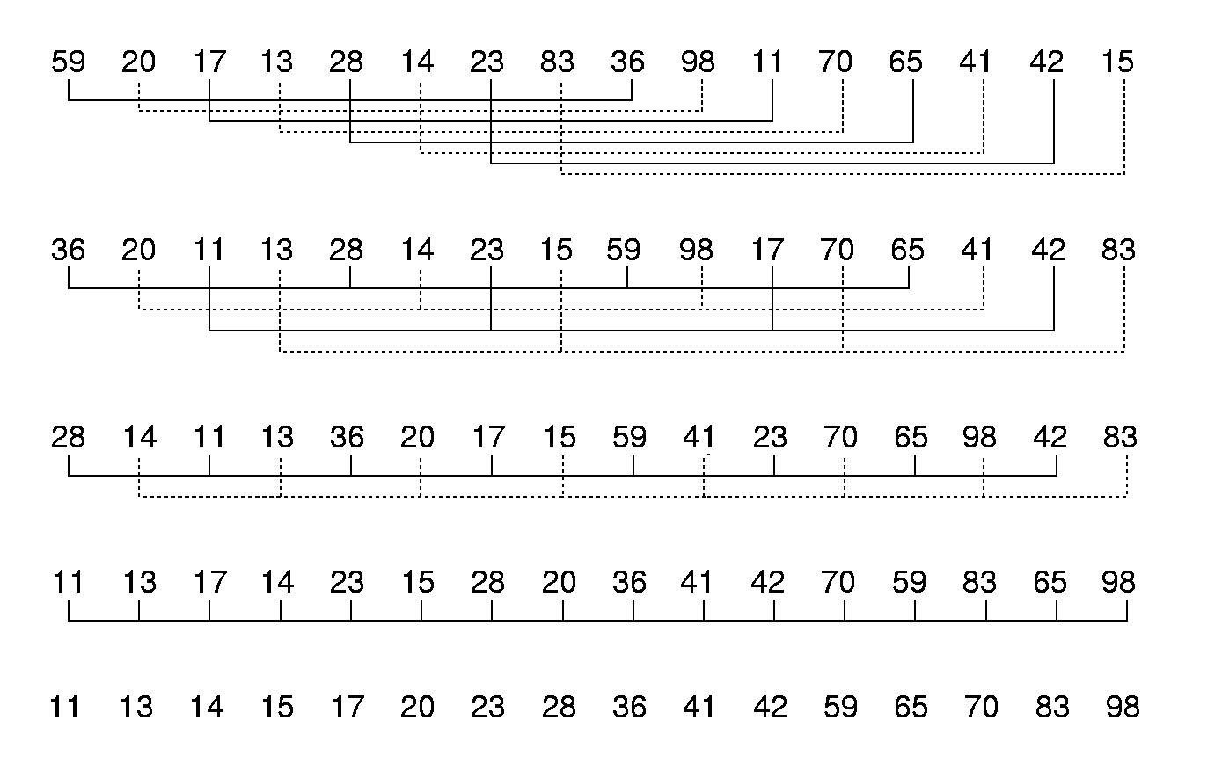
Shellsort (1)
将该序列分成8个子序列，下标间隔为8的倍数的数据组成一个序列
4个子序列，
2个子序列
所有数据构成一个序列，全体进行排序
Notes:
Any increments will work, provided that that the last one is 1 (regular insertion sort). Shellsort takes advantage of Insertion Sort’s best-case performance.

Slide 21

Shellsort(2)
// Modified version of Insertion Sort
template <class Elem>
void inssort2(Elem A[], int n, int from, int incr)
{
for (int i= from + incr; i<n; i+=incr)
for (int j=i; (j> from &&
A[j]< A[j-incr]); j-=incr)
swap(A, j, j-incr);
}
template <class Elem>
void shellsort(Elem A[], int n) { // Shellsort
for (int i=n/2; i>=1; i/=2) // For each incr
for (int j=0; j<i; j++) // Sort sublists
inssort2<Elem>(A, n, j, i);
}
j
i = 4
Notes:
Any increments will work, provided that that the last one is 1 (regular insertion sort). Shellsort takes advantage of Insertion Sort’s best-case performance.

Slide 22
Shellsort(2)
// Modified version of Insertion Sort
template <class Elem>
void inssort2(Elem A[], int n, int from, int incr)
{
for (int i= from + incr; i<n; i+=incr)
for (int j=i; (j> from &&
A[j]< A[j-incr]); j-=incr)
swap(A, j, j-incr);
}
template <class Elem, class Comp>
void shellsort(Elem A[], int n) { // Shellsort
for (int i=n/2; i>=1; i/=2) // For each incr
for (int j=0; j<i; j++) // Sort sublists
inssort2<Elem,Comp>(A, n, j, i);
}
from
j
i
incr= 4
Notes:
Any increments will work, provided that that the last one is 1 (regular insertion sort). Shellsort takes advantage of Insertion Sort’s best-case performance.

Slide 23
Shellsort(2)
// Modified version of Insertion Sort
template <class Elem>
void inssort2(Elem A[], int n, int from, int incr)
{
for (int i= from + incr; i<n; i+=incr)
for (int j=i; (j> from &&
A[j]< A[j-incr]); j-=incr)
swap(A, j, j-incr);
}
template <class Elem, class Comp>
void shellsort(Elem A[], int n) { // Shellsort
for (int i=n/2; i>=1; i/=2) // For each incr
for (int j=0; j<i; j++) // Sort sublists
inssort2<Elem,Comp>(A, n, j, i);
}
28
36
from
j
i
incr= 4
Notes:
Any increments will work, provided that that the last one is 1 (regular insertion sort). Shellsort takes advantage of Insertion Sort’s best-case performance.

Slide 24
Shellsort(2)
// Modified version of Insertion Sort
template <class Elem>
void inssort2(Elem A[], int n, int from, int incr)
{
for (int i= from + incr; i<n; i+=incr)
for (int j=i; (j> from &&
A[j]< A[j-incr]); j-=incr)
swap(A, j, j-incr);
}
template <class Elem, class Comp>
void shellsort(Elem A[], int n) { // Shellsort
for (int i=n/2; i>=1; i/=2) // For each incr
for (int j=0; j<i; j++) // Sort sublists
inssort2<Elem,Comp>(A, n, j, i);
}
28
36
from
j
i
incr= 4
Notes:
Any increments will work, provided that that the last one is 1 (regular insertion sort). Shellsort takes advantage of Insertion Sort’s best-case performance.

Slide 25
Shellsort(3)
希尔排序的特点是：子序列的构成不是简单地“逐段分割”，而是将相隔某个“增量”的记录组成一个子序列。增量有多种取法，最后一个增量必须为1.
例如，在上例中，第一趟排序时的增量为2³，第二趟排序时的增量为2²，后两趟分别为2¹和1。
希尔排序的复杂度：和增量序列有关。哪种增量序列是最佳增量序列仍未知。当增量序列为 ∆[k] = 2^{t-k+1} - 1时，算法复杂度为O(n^{3/2})。 其中t是排序的趟数，1<=k<=t。例如（15，7，3，1）

Slide 26
希尔排序是一种不稳定排序
[初始关键字]: 49 38 65 97 76 13 27 49 55 04
49 13
38 27
首先将该序列分成5个子序列，
下标间隔为5的倍数的数据组成
一个序列
65 49
97 55
间隔5
76 04
一趟排序结果：13 27 49 55 04 49 38 65 97 76
13 55 38 76
将该序列分成3个子序列，下标
间隔为3的倍数的数据组成一个
序列
27 04 65
间隔3
49 49 97
二趟排序结果：13 04 49 38 27 49 55 65 97 76
所有数据构成一个序列，
全体进行排序
三趟排序结果：04 13 27 38 49 49 55 65 76 97
间隔1

Slide 27
Chapter7 Internal Sorting
7.1 Terminology and notation
7.2 Three Θ(n²) Sorting Algorithms
Insertion Sort
Bubble Sort
Selection Sort
7.3 Shell Sort
7.4 Quick Sort
7.5 Merge Sort
7.6 Heap Sort
7.7 BinSort and Radix Sort
7.8 Empirical Comparison of Sorting Algorithms
7.9 Lower bounds for Sorting

Slide 28
Quicksort
Quicksort is a kind of “Divide and Conquer” approach:
Select a value called pivot(支点)
Using the pivot to partition the array :
arranging the records less than the pivot in the left of the pivot, and the records greater than of equal to the pivot in the right of the pivot.
Partition the left and right sub-array recursively, until each sub-array only contains one record.

Slide 29
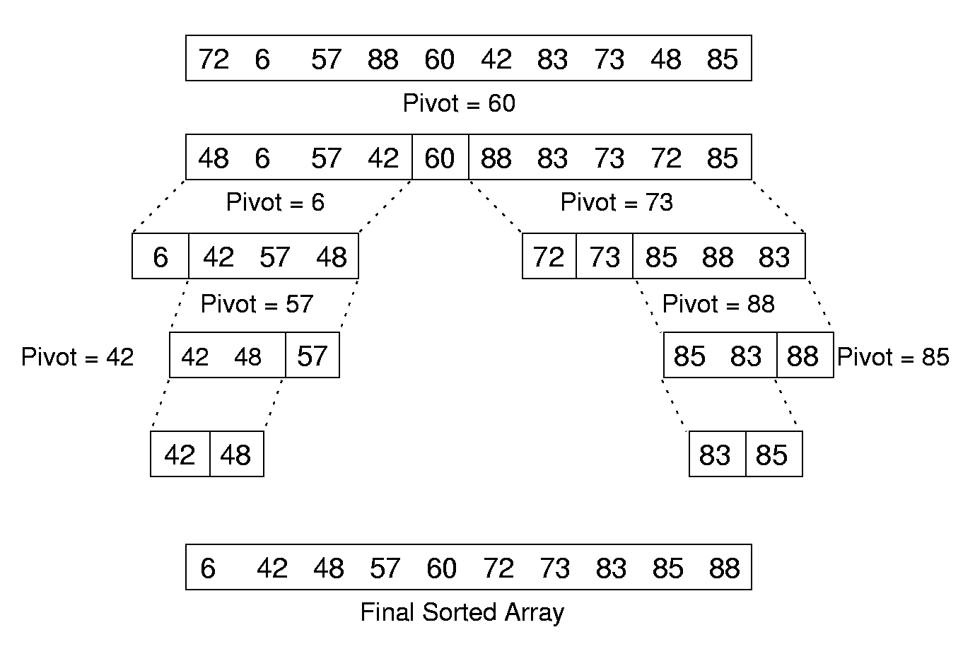
Quicksort Example
29
Notes:
29
问题规模减半：
支点位置确定
左右区间确定

Slide 30
Quicksort algorithm
template <class Elem, class Comp>
void qsort(Elem A[], int i, int j) {
if (j <= i) return; // List too small
int pivotindex = findpivot(A, i, j);
swap(A, pivotindex, j); // Put pivot at end
// k will be first position on right side
int k =
partition<Elem,Comp>(A, i, j, A[j]);
swap(A, k, j); // Put pivot in place
qsort<Elem,Comp>(A, i, k-1);
qsort<Elem,Comp>(A, k+1, j);
}
<
>=
k
i
j
pivot
pivotindex

Slide 31
Locate the pivot
Some choices:
Select the First record.
Select the middle key.
Others.
template <class Elem>
int findpivot(Elem A[], int i, int j)
{ return (i+j)/2; }

Slide 32
Quicksort Partition
template <class Elem>
int partition(Elem A[], int l, int r,Elem& pivot) {
do {
while (A[l] < pivot) l++;
while ((r > l) && A[r] >=pivot)
r--;
swap(A, l, r); // Swap out-of-place values
} while (l < r); // Stop when they cross
return l; // Return first pos on right
}
72
6
57
88
85
42
83
73
48
60
Pivot = 60
l
r

Slide 33
Quicksort Partition
template <class Elem>
int partition(Elem A[], int l, int r,Elem& pivot) {
do {
while (A[l] < pivot) l++;
while ((r > l) && A[r] >=pivot)
r--;
swap(A, l, r); // Swap out-of-place values
} while (l < r); // Stop when they cross
return l; // Return first pos on right
}
48
6
57
88
85
42
83
73
72
60
Pivot = 60
l
r

Slide 34
Quicksort Partition
template <class Elem>
int partition(Elem A[], int l, int r,Elem& pivot) {
do {
while (A[l] < pivot) l++;
while ((r > l) && A[r] >=pivot)
r--;
swap(A, l, r); // Swap out-of-place values
} while (l < r); // Stop when they cross
return l; // Return first pos on right
}
Θ(n).
48
6
57
42
85
88
83
73
72
60
Pivot = 60
l
r
Notes:
L先到： 48 60 7 40
L 后到： 48 6 7 40

Slide 35
Cost of Quicksort （1）
How
Many
layers？
Θ(n).
Θ(n).

Slide 36
Cost of Quicksort （2）
Best case: Balanced partition Θ(n log n)
Worst: Bad partition. Θ(n²)
logn
n
36
Notes:
36
Best and average cases are Θ(n log n). Worst case is Θ(n²).

Slide 37
Cost of Quicksort （3）
Best case: Always partition in half. Θ(n log n)
Worst case: Bad partition. Θ(n²)
Average case:
T(n) = cn + 1/n Σ(T(k) + T(n-1-k))= Θ(n log n)
n-1
k=0
Notes:
Best and average cases are Θ(n log n). Worst case is Θ(n²).

Slide 38
Optimizations for Quicksort
Better Pivot
Select the middle of three values : the first, middle, and last records of the array.
Better algorithm for small sub-arrays
Quicksort is relatively slow when the sub-array size is small
Use the insertion sort to sort the small sub-arrays n(n-1)/2 <nlogn ?
Eliminate recursion

Slide 39
Chapter7 Internal Sorting
7.1 Terminology and notation
7.2 Three Θ(n²) Sorting Algorithms
Insertion Sort
Bubble Sort
Selection Sort
7.3 Shell Sort
7.4 Quick Sort
7.5 Merge Sort
7.6 Heap Sort
7.7 BinSort and Radix Sort
7.8 Empirical Comparison of Sorting Algorithms
7.9 Lower bounds for Sorting

Slide 40
Mergesort
Mergesort is a kind of “Divide and Conquer” approach:
Split a list into two equal sub-lists and sort each sub-lists
Recombine them into one sorted list.
Recursive procedure

Slide 41
Mergesort algorithm (1)
List mergesort(List inlist) {
if (inlist.length() <= 1)return inlist;
List l1 = half of the items from inlist;
List l2 = other half of items from inlist;
return merge(mergesort(l1),
mergesort(l2));
}
36 20 17 13 28 14 23 15
36 20 17 13
28 14 23 15
36 20
17 13
36
20

Slide 42
Mergesort algorithm (2)
List mergesort(List inlist) {
if (inlist.length() <= 1)return inlist;
List l1 = half of the items from inlist;
List l2 = other half of items from inlist;
return merge(mergesort(l1),
mergesort(l2));
}
36 20 17 13 28 14 23 15
36 20 17 13
28 14 23 15
20 36
17 13
36
20
17
13

Slide 43
Mergesort algorithm (2)
List mergesort(List inlist) {
if (inlist.length() <= 1)return inlist;
List l1 = half of the items from inlist;
List l2 = other half of items from inlist;
return merge(mergesort(l1),
mergesort(l2));
}
36 20 17 13 28 14 23 15
36 20 17 13
28 14 23 15
20 36
13 17
36
20
17
13

Slide 44
Mergesort algorithm (2)
List mergesort(List inlist) {
if (inlist.length() <= 1)return inlist;
List l1 = half of the items from inlist;
List l2 = other half of items from inlist;
return merge(mergesort(l1),
mergesort(l2));
}
36 20 17 13 28 14 23 15
13 17 20 36
28 14 23 15
20 36
13 17
28 14
23 15
36
20
17
13
28
14

Slide 45
Mergesort algorithm (2)
List mergesort(List inlist) {
if (inlist.length() <= 1)return inlist;
List l1 = half of the items from inlist;
List l2 = other half of items from inlist;
return merge(mergesort(l1),
mergesort(l2));
}
36 20 17 13 28 14 23 15
13 17 20 36
28 14 23 15
20 36
13 17
14 28
23 15
36
20
17
13
28
14
23
15

Slide 46
Mergesort algorithm (2)
List mergesort(List inlist) {
if (inlist.length() <= 1)return inlist;
List l1 = half of the items from inlist;
List l2 = other half of items from inlist;
return merge(mergesort(l1),
mergesort(l2));
}
36 20 17 13 28 14 23 15
13 17 20 36
28 14 23 15
20 36
13 17
14 28
15 23
36
20
17
13
28
14
23
15

Slide 47
Mergesort algorithm (2)
List mergesort(List inlist) {
if (inlist.length() <= 1)return inlist;
List l1 = half of the items from inlist;
List l2 = other half of items from inlist;
return merge(mergesort(l1),
mergesort(l2));
}
36 20 17 13 28 14 23 15
13 17 20 36
14 15 23 28
20 36
13 17
14 28
15 23
36
20
17
13
28
14
23
15

Slide 48
Mergesort algorithm (2)
List mergesort(List inlist) {
if (inlist.length() <= 1)return inlist;
List l1 = half of the items from inlist;
List l2 = other half of items from inlist;
return merge(mergesort(l1),
mergesort(l2));
}
36 20 17 13 28 14 23 15
13 14 15 17 20 23 28 36
13 17 20 36
14 15 23 28
20 36
13 17
14 28
15 23
36
20
17
13
28
14
23
15

Slide 49
Mergesort Implementation
template <class Elem>
void mergesort(Elem A[], Elem temp[],
int left, int right) {
int mid = (left+right)/2;
if (left == right) return;
mergesort<Elem>(A, temp, left, mid);
mergesort<Elem>(A, temp, mid+1, right);
mid
left
right
A
36 20 17 13 28 14 23 15
Notes:
Mergesort is tricky to implement. The problem is to have the recursion work correctly with the space that stores the values. We do not want to continuously create new arrays.
This implementation copies the sorted sublists into a temporary array and merges back to the original array.

Slide 50
Mergesort Implementation
template <class Elem>
void mergesort(Elem A[], Elem temp[],
int left, int right) {
int mid = (left+right)/2;
if (left == right) return;
mergesort<Elem>(A, temp, left, mid);
mergesort<Elem>(A, temp, mid+1, right);
mid
left
right
A
13 17 20 36 14 15 23 28
Notes:
Mergesort is tricky to implement. The problem is to have the recursion work correctly with the space that stores the values. We do not want to continuously create new arrays.
This implementation copies the sorted sublists into a temporary array and merges back to the original array.

Slide 51
Mergesort Implementation
for (int i=left; i<=right; i++) // Copy
temp[i] = A[i];
int i1 = left; int i2 = mid + 1;
for (int curr=left; curr<=right; curr++) {
if (i1 == mid+1) // Left exhausted
A[curr] = temp[i2++];
else if (i2 > right) // Right exhausted
A[curr] = temp[i1++];
else if (temp[i1] < temp[i2])
A[curr] = temp[i1++];
else A[curr] = temp[i2++];
}}
curr
A
13 17 20 36 14 15 23 28
left
mid
right
temp
13 17 20 36 14 15 23 28
i1
i2
Notes:
Mergesort is tricky to implement. The problem is to have the recursion work correctly with the space that stores the values. We do not want to continuously create new arrays.
This implementation copies the sorted sublists into a temporary array and merges back to the original array.

Slide 52
Mergesort Implementation
for (int i=left; i<=right; i++) // Copy
temp[i] = A[i];
int i1 = left; int i2 = mid + 1;
for (int curr=left; curr<=right; curr++) {
if (i1 == mid+1) // Left exhausted
A[curr] = temp[i2++];
else if (i2 > right) // Right exhausted
A[curr] = temp[i1++];
else if (temp[i1] < temp[i2])
A[curr] = temp[i1++];
else A[curr] = temp[i2++];
}}
curr
A
13 17 20 36 14 15 23 28
left
mid
right
temp
13 17 20 36 14 15 23 28
i1
i2
Notes:
Mergesort is tricky to implement. The problem is to have the recursion work correctly with the space that stores the values. We do not want to continuously create new arrays.
This implementation copies the sorted sublists into a temporary array and merges back to the original array.

Slide 53
Mergesort Implementation
for (int i=left; i<=right; i++) // Copy
temp[i] = A[i];
int i1 = left; int i2 = mid + 1;
for (int curr=left; curr<=right; curr++) {
if (i1 == mid+1) // Left exhausted
A[curr] = temp[i2++];
else if (i2 > right) // Right exhausted
A[curr] = temp[i1++];
else if (temp[i1] < temp[i2])
A[curr] = temp[i1++];
else A[curr] = temp[i2++];
}}
curr
A
13 14 20 36 14 15 23 28
left
mid
right
temp
13 17 20 36 14 15 23 28
i1
i2
Notes:
Mergesort is tricky to implement. The problem is to have the recursion work correctly with the space that stores the values. We do not want to continuously create new arrays.
This implementation copies the sorted sublists into a temporary array and merges back to the original array.

Slide 54
Mergesort Implementation
for (int i=left; i<=right; i++) // Copy
temp[i] = A[i];
int i1 = left; int i2 = mid + 1;
for (int curr=left; curr<=right; curr++) {
if (i1 == mid+1) // Left exhausted
A[curr] = temp[i2++];
else if (i2 > right) // Right exhausted
A[curr] = temp[i1++];
else if (temp[i1] < temp[i2])
A[curr] = temp[i1++];
else A[curr] = temp[i2++];
}}
curr
A
13 14 15 36 14 15 23 28
left
mid
right
temp
13 17 20 36 14 15 23 28
i1
i2
Notes:
Mergesort is tricky to implement. The problem is to have the recursion work correctly with the space that stores the values. We do not want to continuously create new arrays.
This implementation copies the sorted sublists into a temporary array and merges back to the original array.

Slide 55
Mergesort Implementation
for (int i=left; i<=right; i++) // Copy
temp[i] = A[i];
int i1 = left; int i2 = mid + 1;
for (int curr=left; curr<=right; curr++) {
if (i1 == mid+1) // Left exhausted
A[curr] = temp[i2++];
else if (i2 > right) // Right exhausted
A[curr] = temp[i1++];
else if (temp[i1] < temp[i2])
A[curr] = temp[i1++];
else A[curr] = temp[i2++];
}}
curr
A
13 14 15 17 14 15 23 28
left
mid
right
temp
13 17 20 36 14 15 23 28
i1
i2
Notes:
Mergesort is tricky to implement. The problem is to have the recursion work correctly with the space that stores the values. We do not want to continuously create new arrays.
This implementation copies the sorted sublists into a temporary array and merges back to the original array.

Slide 56
Mergesort Implementation
for (int i=left; i<=right; i++) // Copy
temp[i] = A[i];
int i1 = left; int i2 = mid + 1;
for (int curr=left; curr<=right; curr++) {
if (i1 == mid+1) // Left exhausted
A[curr] = temp[i2++];
else if (i2 > right) // Right exhausted
A[curr] = temp[i1++];
else if (temp[i1] < temp[i2])
A[curr] = temp[i1++];
else A[curr] = temp[i2++];
}}
curr
A
13 14 15 17 20 15 23 28
left
mid
right
temp
13 17 20 36 14 15 23 28
i1
i2
Notes:
Mergesort is tricky to implement. The problem is to have the recursion work correctly with the space that stores the values. We do not want to continuously create new arrays.
This implementation copies the sorted sublists into a temporary array and merges back to the original array.

Slide 57
Mergesort Implementation
for (int i=left; i<=right; i++) // Copy
temp[i] = A[i];
int i1 = left; int i2 = mid + 1;
for (int curr=left; curr<=right; curr++) {
if (i1 == mid+1) // Left exhausted
A[curr] = temp[i2++];
else if (i2 > right) // Right exhausted
A[curr] = temp[i1++];
else if (temp[i1] < temp[i2])
A[curr] = temp[i1++];
else A[curr] = temp[i2++];
}}
curr
A
13 14 15 17 20 23 23 28
left
mid
right
temp
13 17 20 36 14 15 23 28
i1
i2
Notes:
Mergesort is tricky to implement. The problem is to have the recursion work correctly with the space that stores the values. We do not want to continuously create new arrays.
This implementation copies the sorted sublists into a temporary array and merges back to the original array.

Slide 58
Mergesort Implementation
for (int i=left; i<=right; i++) // Copy
temp[i] = A[i];
int i1 = left; int i2 = mid + 1;
for (int curr=left; curr<=right; curr++) {
if (i1 == mid+1) // Left exhausted
A[curr] = temp[i2++];
else if (i2 > right) // Right exhausted
A[curr] = temp[i1++];
else if (temp[i1] < temp[i2])
A[curr] = temp[i1++];
else A[curr] = temp[i2++];
}}
curr
A
13 14 15 17 20 23 28 28
left
mid
right
temp
13 17 20 36 14 15 23 28
i1
i2
Notes:
Mergesort is tricky to implement. The problem is to have the recursion work correctly with the space that stores the values. We do not want to continuously create new arrays.
This implementation copies the sorted sublists into a temporary array and merges back to the original array.

Slide 59
Mergesort Implementation
for (int i=left; i<=right; i++) // Copy
temp[i] = A[i];
int i1 = left; int i2 = mid + 1;
for (int curr=left; curr<=right; curr++) {
if (i1 == mid+1) // Left exhausted
A[curr] = temp[i2++];
else if (i2 > right) // Right exhausted
A[curr] = temp[i1++];
else if (temp[i1] < temp[i2])
A[curr] = temp[i1++];
else A[curr] = temp[i2++];
}}
curr
A
13 14 15 17 20 23 28 36
left
mid
right
temp
13 17 20 36 14 15 23 28
i1
i2
Notes:
Mergesort is tricky to implement. The problem is to have the recursion work correctly with the space that stores the values. We do not want to continuously create new arrays.
This implementation copies the sorted sublists into a temporary array and merges back to the original array.

Slide 60
Optimized Mergesort (1)
template <class Elem>
void mergesort(Elem A[], Elem temp[],
int left, int right) {
int mid = (left+right)/2;
if (left == right) return;
mergesort<Elem>(A, temp, left, mid);
mergesort<Elem>(A, temp, mid+1, right);
for (int i=left; i<=right; i++) // Copy
temp[i] = A[i];
int i1 = left; int i2 = mid + 1;
for (int curr=left; curr<=right; curr++) {
if (i1 == mid+1) // Left exhausted
A[curr] = temp[i2++];
else if (i2 > right) // Right exhausted
A[curr] = temp[i1++];
else if (temp[i1] < temp[i2])
A[curr] = temp[i1++];
else A[curr] = temp[i2++];
}}
Notes:
Two optimizations. First, use insertion sort to sort small sublists. Second, have the two sublists run toward each other, so that their high ends meet in the middle. In this way, there is no need to test for end of list.

Slide 61
Optimized Mergesort (2)
for (i=mid; i>=left; i--) temp[i] = A[i];
for (j=1; j<=right-mid; j++)
temp[right-j+1] = A[j+mid];
for (i=left,j=right,k=left; k<=right; k++)
if (temp[i] < temp[j]) A[k] = temp[i++];
else A[k] = temp[j--];
}
k
A
13 17 20 36 14 15 23 28
left
mid
right
temp
13 17 20 36 28 23 15 14
i
j
Notes:
Two optimizations. First, use insertion sort to sort small sublists. Second, have the two sublists run toward each other, so that their high ends meet in the middle. In this way, there is no need to test for end of list.

Slide 62
Optimized Mergesort (2)
for (i=mid; i>=left; i--) temp[i] = A[i];
for (j=1; j<=right-mid; j++)
temp[right-j+1] = A[j+mid];
for (i=left,j=right,k=left; k<=right; k++)
if (temp[i] < temp[j]) A[k] = temp[i++];
else A[k] = temp[j--];
}
k
A
13 17 20 36 14 15 23 28
left
mid
right
temp
13 17 20 36 28 23 15 14
i
j
Notes:
Two optimizations. First, use insertion sort to sort small sublists. Second, have the two sublists run toward each other, so that their high ends meet in the middle. In this way, there is no need to test for end of list.

Slide 63
Optimized Mergesort (2)
for (i=mid; i>=left; i--) temp[i] = A[i];
for (j=1; j<=right-mid; j++)
temp[right-j+1] = A[j+mid];
for (i=left,j=right,k=left; k<=right; k++)
if (temp[i] < temp[j]) A[k] = temp[i++];
else A[k] = temp[j--];
}
k
A
13 14 20 36 14 15 23 28
left
mid
right
temp
13 17 20 36 28 23 15 14
i
j
Notes:
Two optimizations. First, use insertion sort to sort small sublists. Second, have the two sublists run toward each other, so that their high ends meet in the middle. In this way, there is no need to test for end of list.

Slide 64
Optimized Mergesort (2)
for (i=mid; i>=left; i--) temp[i] = A[i];
for (j=1; j<=right-mid; j++)
temp[right-j+1] = A[j+mid];
for (i=left,j=right,k=left; k<=right; k++)
if (temp[i] < temp[j]) A[k] = temp[i++];
else A[k] = temp[j--];
}
k
A
13 14 15 36 14 15 23 28
left
mid
right
temp
13 17 20 36 28 23 15 14
i
j
Notes:
Two optimizations. First, use insertion sort to sort small sublists. Second, have the two sublists run toward each other, so that their high ends meet in the middle. In this way, there is no need to test for end of list.

Slide 65
Optimized Mergesort (2)
for (i=mid; i>=left; i--) temp[i] = A[i];
for (j=1; j<=right-mid; j++)
temp[right-j+1] = A[j+mid];
for (i=left,j=right,k=left; k<=right; k++)
if (temp[i] < temp[j]) A[k] = temp[i++];
else A[k] = temp[j--];
}
k
A
13 14 15 17 14 15 23 28
left
mid
right
temp
13 17 20 36 28 23 15 14
i
j
Notes:
Two optimizations. First, use insertion sort to sort small sublists. Second, have the two sublists run toward each other, so that their high ends meet in the middle. In this way, there is no need to test for end of list.

Slide 66
Optimized Mergesort (2)
for (i=mid; i>=left; i--) temp[i] = A[i];
for (j=1; j<=right-mid; j++)
temp[right-j+1] = A[j+mid];
for (i=left,j=right,k=left; k<=right; k++)
if (temp[i] < temp[j]) A[k] = temp[i++];
else A[k] = temp[j--];
}
k
A
13 14 15 17 20 15 23 28
left
mid
right
temp
13 17 20 36 28 23 15 14
i
j
Notes:
Two optimizations. First, use insertion sort to sort small sublists. Second, have the two sublists run toward each other, so that their high ends meet in the middle. In this way, there is no need to test for end of list.

Slide 67
Optimized Mergesort (2)
for (i=mid; i>=left; i--) temp[i] = A[i];
for (j=1; j<=right-mid; j++)
temp[right-j+1] = A[j+mid];
for (i=left,j=right,k=left; k<=right; k++)
if (temp[i] < temp[j]) A[k] = temp[i++];
else A[k] = temp[j--];
}
k
A
13 14 15 17 20 23 23 28
left
mid
right
temp
13 17 20 36 28 23 15 14
i
j
Notes:
Two optimizations. First, use insertion sort to sort small sublists. Second, have the two sublists run toward each other, so that their high ends meet in the middle. In this way, there is no need to test for end of list.

Slide 68
Optimized Mergesort (2)
for (i=mid; i>=left; i--) temp[i] = A[i];
for (j=1; j<=right-mid; j++)
temp[right-j+1] = A[j+mid];
for (i=left,j=right,k=left; k<=right; k++)
if (temp[i] < temp[j]) A[k] = temp[i++];
else A[k] = temp[j--];
}
k
A
13 14 15 17 20 23 28 28
left
mid
right
temp
13 17 20 36 28 23 15 14
i
j
Notes:
Two optimizations. First, use insertion sort to sort small sublists. Second, have the two sublists run toward each other, so that their high ends meet in the middle. In this way, there is no need to test for end of list.

Slide 69
Optimized Mergesort (2)
for (i=mid; i>=left; i--) temp[i] = A[i];
for (j=1; j<=right-mid; j++)
temp[right-j+1] = A[j+mid];
for (i=left,j=right,k=left; k<=right; k++)
if (temp[i] < temp[j]) A[k] = temp[i++];
else A[k] = temp[j--];
}
k
A
13 14 15 17 20 23 28 36
mid
right
Θ(n).
left
temp
13 17 20 36 28 23 15 14
i
j
Notes:
Two optimizations. First, use insertion sort to sort small sublists. Second, have the two sublists run toward each other, so that their high ends meet in the middle. In this way, there is no need to test for end of list.

Slide 70
Mergesort Cost
Time :
Θ(n log n) in the best, average, and worst cases.
Space :
2n.
36 20 17 13 28 14 23 15
13 14 15 17 20 23 28 36
Θ(n)
13 17 20 36
14 15 23 28
Θ(n)
logn
20 36
13 17
14 28
15 23
Θ(n)
36
20
17
13
28
14
23
15
Θ(n)
Notes:
Cost is Θ(n log n) in the best, average, and worst cases.
When merging linked lists, send records to alternating linked lists, mergesort each, then merge the sublists.

Slide 71
Chapter7 Internal Sorting
7.1 Terminology and notation
7.2 Three Θ(n²) Sorting Algorithms
Insertion Sort
Bubble Sort
Selection Sort
7.3 Shell Sort
7.4 Quick Sort
7.5 Merge Sort
7.6 Heap Sort
7.7 BinSort and Radix Sort
7.8 Empirical Comparison of Sorting Algorithms
7.9 Lower bounds for Sorting

Slide 72
Function of Heaps
?
96
Get the max = 96
83
27
83
27
38
11
09
38
11
09
Reorganized into a heap
83
Get the max = 83
… …
38
27
09
11
72

Slide 73
Heap class (1)
template<class Elem> class maxheap{
private:
Elem* Heap; // Pointer to the heap array
int size; // Maximum size of the heap
int n; // Number of elems now in heap
96
83
27
38
11
9
96
83
27
38
11
9
Heap
73
Notes:
73

Slide 74
Heap class(2)
public:
maxheap(Elem* h, int num, int max)
{Heap = h; n = num; size = max; buildHeap();}
9
27
83
Heap
9
27
83
11
38
96
11
38
96
h
96
buildHeap()
83
27
96
83
27
38
11
9
Heap
38
11
9
74
Notes:
74

Slide 75
RemoveMax
Bool removemax(Elem& it) {
if (n == 0) return false; // Heap is empty
swap(Heap, 0, --n); // Swap max with end
if (n != 0) siftdown(0);
it = Heap[n]; // Return max value
return true;
}
Θ(log n)
7
3
6
Sift down
5
6
5
6
3
5
4
2
1
3
4
2
1
7
4
2
1
7
7
5
6
4
2
1
3
6
5
3
4
2
1
7
75
Notes:
75

Slide 76
HeapSort（1）
7
6
6
5
3
5
removemax
4
2
1
3
4
2
1
7
7
5
6
4
2
1
3
6
5
3
4
2
1
7
4
removemax
5
removemax
3
2
3
4
1
5
6
7
1
2
6
7
5
4
76
3
1
2
6
7
5
4
3
1
5
6
7
Notes:
76

Slide 77
HeapSort （1）
3
2
2
1
1
3
removemax
4
5
6
7
4
5
6
7
3
2
1
4
5
6
7
2
1
3
4
5
6
7
4
removemax
1
2
3
2
3
1
5
6
7
4
5
6
7
5
4
3
1
5
6
7
1
2
3
4
5
6
7
77
Notes:
77

Slide 78
HeapSort （2）
template <class Elem>
void heapsort(Elem A[], int n) { //Heapsort
Elem mval;
maxheap<Elem> H(A, n, n);
for (int i=0; i<n; i++) // Now sort
H.removemax(mval);
}
Cost:
build the heap ： Θ(n)
removemax: Θ(log n)
removemax n times: Θ(nlog n)
Θ(n log n)
78
Notes:
78
The time to build the heap is Θ(n). The time to remove the n elements is Θ(n log n). So, if we only remove k elements, the total cost is Θ(n + k log n).
Compare to sorting with a BST. The heap has no overhead, and is always balanced. Further, the time to build the BST is expensive, while removing the elements once the BST is built is cheap.

Slide 79
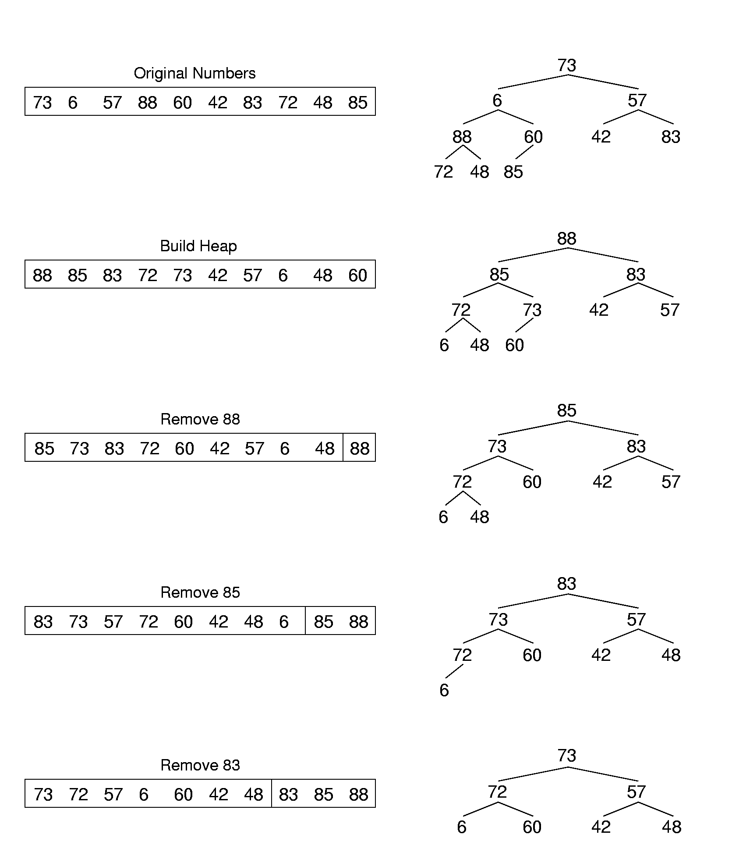
Heapsort Example (1)
Notes:
The time to build the heap is Θ(n). The time to remove the n elements is Θ(n log n). So, if we only remove k elements, the total cost is Θ(n + k log n).
Compare to sorting with a BST. The heap has no overhead, and is always balanced. Further, the time to build the BST is expensive, while removing the elements once the BST is built is cheap.

Slide 80
Heapsort Example (2)
Notes:
The time to build the heap is Θ(n). The time to remove the n elements is Θ(n log n). So, if we only remove k elements, the total cost is Θ(n + k log n).
Compare to sorting with a BST. The heap has no overhead, and is always balanced. Further, the time to build the BST is expensive, while removing the elements once the BST is built is cheap.

Slide 81
Chapter7 Internal Sorting
7.1 Terminology and notation
7.2 Three Θ(n²) Sorting Algorithms
Insertion Sort
Bubble Sort
Selection Sort
7.3 Shell Sort
7.4 Quick Sort
7.5 Merge Sort
7.6 Heap Sort
7.7 BinSort and Radix Sort
7.8 Empirical Comparison of Sorting Algorithms
7.9 Lower bounds for Sorting

Slide 82
Binsort (箱排序 ) （1）
原理：：设置若干个箱子，依次扫描待排序的记录R[0]，R[1]，…，R[n-1]，把关键字等于k的记录全都装入到第k个箱子里(分配)，然后按序号依次将各非空的箱子首尾连接起来(收集)。
3
5
1
8
Records
分配
Bins （箱子）
0 1 2 3 4 5 6 7 8 9
Notes:
This sort is Θ(n), but it only works on a permutation of the values from 0 to n-1.

Slide 83
Binsort (箱排序 ) （2）
原理：：设置若干个箱子，依次扫描待排序的记录R[0]，R[1]，…，R[n-1]，把关键字等于k的记录全都装入到第k个箱子里(分配)，然后按序号依次将各非空的箱子首尾连接起来(收集)。
Records
收集
1
3
5
8
Bins （箱子）
0 1 2 3 4 5 6 7 8 9
Notes:
This sort is Θ(n), but it only works on a permutation of the values from 0 to n-1.

Slide 84
Binsort (箱排序 ) （3）
A simple, efficient sort:
for (i=0; i<n; i++)
B[A[i]] = A[i];
How extend Binsort to support:
Allow mutiple records with a same key
A
3
1
0
2
Records
B
Bins （箱子）
0 1 2 3
Notes:
This sort is Θ(n), but it only works on a permutation of the values from 0 to n-1.

Slide 85
Binsort (箱排序 ) （4）
Extension of Binsort to support mutiple records with a same key
A
3
8
1
8
4
Records
B
Bins （箱子）
0 1 2 3 4 5 6 7 8 9
Notes:
This sort is Θ(n), but it only works on a permutation of the values from 0 to n-1.

Slide 86
Binsort (箱排序 ) （4）
Extension of Binsort to support mutiple records with a same key
Cost: Θ(n + MaxKeyValue).
Records
8
1
3
4
8
B
Bins （箱子）
0 1 2 3 4 5 6 7 8 9
Notes:
This sort is Θ(n), but it only works on a permutation of the values from 0 to n-1.

Slide 87
Binsort (箱排序 ) （5）
箱子的数目和key的取值范围有关
如果records的数目<<key的取值范围，则较为低效 Θ(n + MaxKeyValue).
箱排序适合records的数目和箱子数目(key的取值范围)比较接近的情形
3
5
1
8
Records
Bins （箱子）
0 1 2 3 4 5 6 7 8 9

Slide 88
Radix Sort （基排序)
基数排序(Radix Sort)是对箱排序的改进和推广
假设任一记录R[i]的关键字均由d个分量组成， K_{d-1}K_{d-2…}K₀
基数排序的基本思想是：从低位到高位依次对K_{j}(j=0，1，…，d-1)进行箱排序。在第d趟箱排序中，所需的箱子数等于基数r_{d}，这就是"基数排序"名称的由来

Slide 89
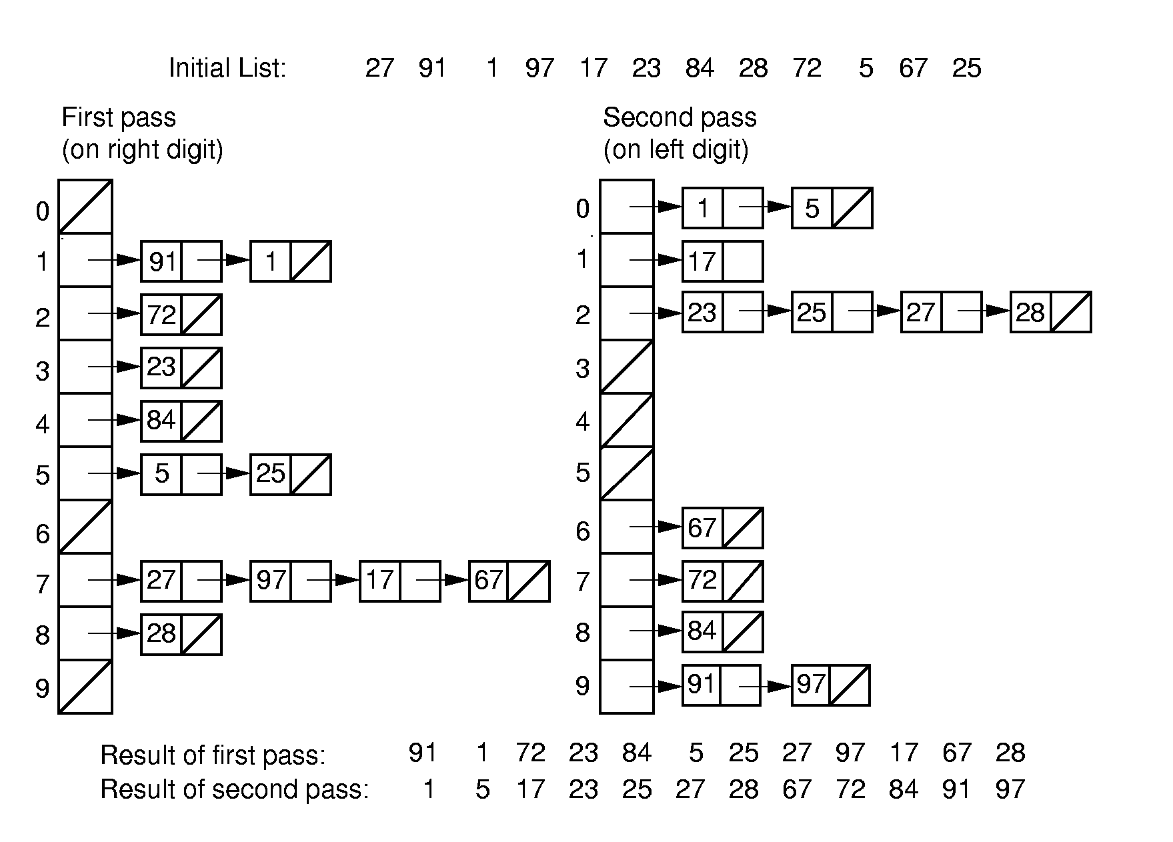
Radix Sort (1)
Θ((n + r)k) (k is the digit count of a keyword, r is the radix )

Slide 90
Radix Sort Cost
Cost: Θ((n + r)k)
//n – number of the records
//k – digit count of a keyword
//r – radix
If there are n distinct keys, then k must be at least log_{r} n
Thus, Radix Sort is Ω(n log n) in general case
Notes:
r is small and can be viewed as a constant.

Slide 91
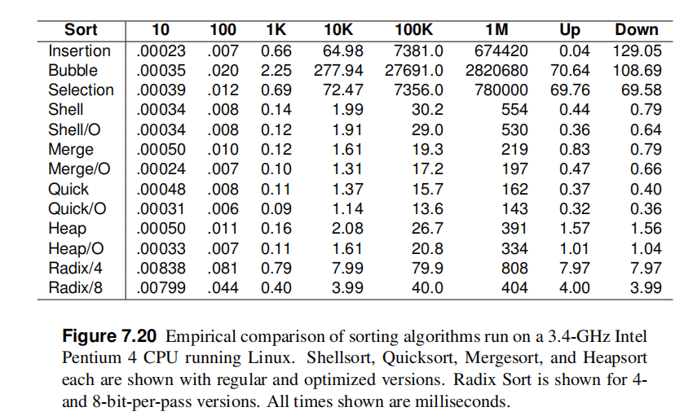
Empirical Comparison (1)
Notes:
Window 98
Note the quick sort is fastest
heap is slower
Radix is slower because / %
Insertion is quick when the sequence is in order.

Slide 92
Sorting Lower Bound
Sorting is O(n log n) (average, worst cases) , because we know of algorithms with this upper bound.
We would like to know a lower bound for all possible sorting algorithms.
We will now prove Ω(n log n) lower bound for sorting.

Slide 93
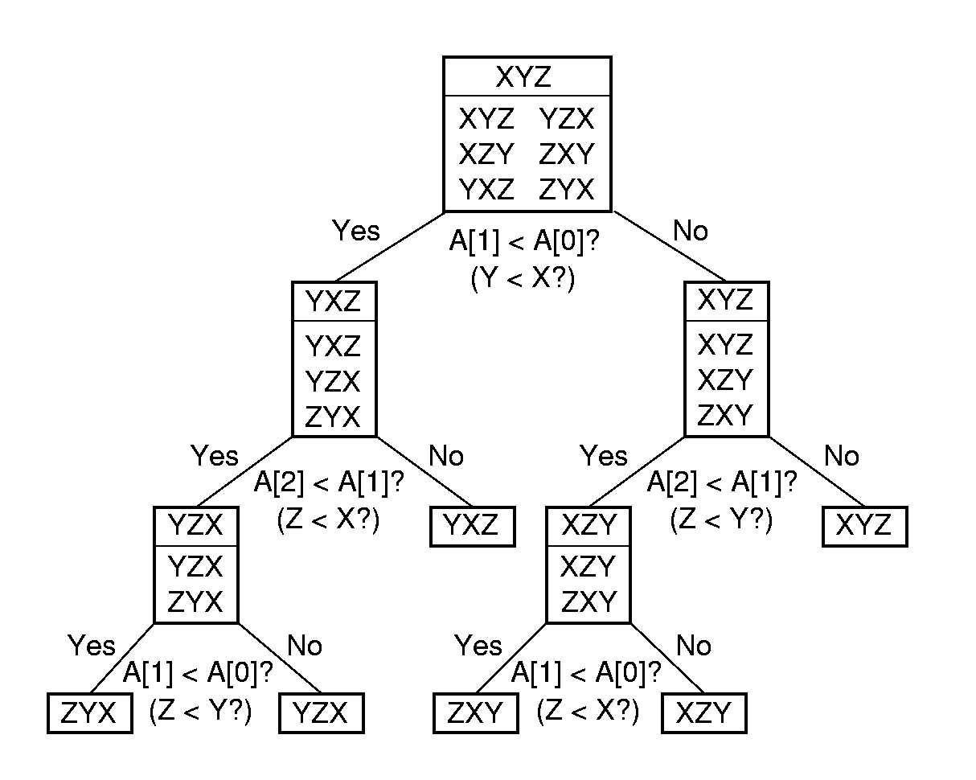
Decision Trees
?
n !

Slide 94
Lower Bound Proof
There are n! permutations.
A sorting algorithm can be viewed as determining which permutation has been input.
Each leaf node of the decision tree corresponds to one permutation.
A tree with n nodes has Ω(log n) levels, so the tree with n! leaves has Ω(log n!) = Ω(n log n) levels
Sorting is Ω (n log n) (average, worst cases)

